Slide 1
just-training.eu
Interacting safely in a digital setting
Partner: IWS

Slide 2
Learning outcomes
At the end of this module you will:
get familiar with cybersecurity and understand the basic utility tools (VPN, Antimalware, cloud apps)
develop your responsibility in relation to netiquette
understand how to maintain privacy when sharing content online

Slide 3
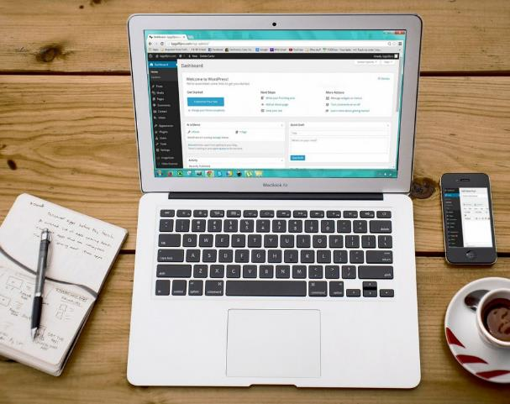
Index
Cybersecurity tips and tricks
Introduction
Keep yourself updated
Use backups!
Passwords and Multi-factor authentications
Safe practices
Safeguard your privacy
Watch your netiquette
Tools to enhance ICT security
VPNs
Antimalware
The Cloud

Slide 4
1.1 Cybersecurity tips and tricks: Introduction
We live in an increasingly interconnected world. This comprises the feeling the need to share the best of our last trip to our Instagram circle, or shifting the topic from leisure to work, every call or email exchange we participate in during our educational and/or work life.
Unknowingly, these exchanges of information contain plenty of data about us, often sensible, which can be stolen and collected by people who want to illegally take advantage of it.
This is why having cybersecurity protocols or just practices (which does not only mean installing an antivirus and then stop caring) is essential for our online life.

Slide 5
1.2 Cybersecurity tips and tricks: Keep yourself updated
Our devices usually bother us with inconvenient “new software update” notifications. Despite sometimes not changing anything at first glance, these updates are very useful, as they patch recently discovered bugs and security issues that might pose a risk to our devices and the information they contain
However, these software updates might be short-lived since hackers are always on the lookout to find software vulnerabilities, which stresses the importance of keeping our devices updated.

Slide 6
1.3 Cybersecurity tips and tricks: Use backups!
Keeping a separate, additional copy of your files is a safe bet when, despite our efforts, the worst happens and the files get corrupted or our system suffers a cyberattack. To avoid it, our files can be safely stored in an external drive and/or online cloud applications.
Contrary to common belief, backup versions should be created during the elaboration process and not only once the file is finished. In this way you can easily circle back to previous iterations of the file in case something goes wrong mid draft.

Slide 7
1.4 Cybersecurity tips and tricks: Passwords and multi-factor authentication
Often overlooked, passwords are a vital part of cybersecurity. Despite the hassle of remembering and introducing them character-perfect, long passwords with as m4nY! types of characters as possible are a must. Needless to say, using your date of birth (and the like) is not an option.
Also, due to frequent security breaches, passwords can be easily compromised, so keep different passwords on every device or account and remember to change them regularly!
Multi-factor authentication is a system that makes it harder for cybercriminals by requiring additional credentials beyond the password to enter your account e.g., an SMS code, a call or using a specific app.

Slide 8
2.1 Safe practices: Safeguard your privacy!
We tend to associate cybersecurity with hackers using state-of-the-art tools to break into our accounts. The truth is that most of their success comes from googling and gathering “public information” from social media, blogs and forums.
In this way, if we like to use a combination of our pet’s name, mother’s surname, door number, etc. for our passwords, it is a matter of time before a hacker can gather it all from here and there, recombine it and break in.
Reconsider what “private information” means to you. Go back on your timeline(s), look for any pictures of your ID/credit card/personal documents (could be goodbye, appreciation or mock posts) and delete them. Also, pay attention to any profiles having too much unnecessary personal information.
Remember: if you don’t want any information to be seen by strangers, just don’t post it!

Slide 9
2.2 Safe practices: Watch your netiquette (1)
The “netiquette” is a set of rules of courtesy designed to ease online coexistence, just as we have social conventions for the offline world such as waving, greeting and saying “please”.
Also, as in real life, bear in mind that this code of conduct is not immutable and depends on the context. A good example of this is the set of rules usually sticky posted on Facebook groups or forums.
The original “netiquette” rules by Virginia Shea (1994) are still valid with some updates, such as in the following example:

Slide 10
2.3 Safe practices: Watch your netiquette (2)
Avoid using online communities as Google substitutes – Basically, try to look for previous posts/threads that already answered the issue.
Restrict the use of extra punctuation marks, abbreviations, emojis, capital letters and alternative spellings – C0Z N0B0DY wantz T0 R3AD MESSAG3S L1KE th1s, rite???? 😃😃😃
Do not spam your own products or services – Usually, there are separate, specific spaces for that. If you can’t see them, you’re not at the right place.
Do not send any personal or private information – Please refer to the previous section
Give authors due credit – Not only from a legal point of view, but also because, while people hate being plagiarised they do love seeing their work shared.

Slide 11
3.1 Tools to enhance ICT security: VPNs
Not everything is going to be measures, rules and habits. Fortunately, there are plenty of tools designed to combat cyberthreats like VPNs, Antimalware and Cloud apps.
VPNs are filters that mask your online identity and encrypt your data. It does so by connecting to a private server that scrambles your data, blocking external access to them and making them unreadable if stolen.
Additionally, most VPNs have servers in several countries, which means we have plenty of options to disguise our IP as a foreign one and access geo-blocked contents unavailable in our country:
and are two reasonably paid options that let us browse safely.
Moreover, and also offer attractive and reliable free plans.

Slide 12
3.2 Tools to enhance ICT security: Antimalware
Despite being commonly called “Antivirus”, Antimalware software is designed to detect, quarantine and eliminate any cyberthreats, not only viruses.
While viruses are designed to replicate themselves and make devices malfunction, malware is an umbrella term for any kind of malicious software that spreads spam and ads and steals information and passwords (and might even ask for a ransom!).
Nowadays, it is true that most antimalware software has an antivirus app and vice versa, with a big range of functionalities and modalities:
As per paid options, , and stand out.
What’s more, the free versions of and also offer a first-rate service.

Slide 13
3.3 Tools to enhance ICT security: The Cloud
“The Cloud” is an online hosting service that allows users to upload, modify, store and share their files.
Storing your files online in private servers safeguards said files against any local attack or corruption as well as preventing problems with physical hard drives such as lack of space, losses or deterioration.
Despite its name, “the Cloud” is not a unique entity, but every provider has their own and that is why there are several options:
A popular option despite veering to paid plans, offers a 2GB free plan.
With 5 GB and 15 GB respectively, Microsoft’s and also offer full integration within their environments.
Finally, though mainly used for file sharing, allows free users to store up to 20GB

Slide 14
Summing up
Cybersecurity
Privacy
Protocols are as important as applications
Be very mindful of what you share online.
Responsibility
Utility tools
They include VPNs, Antimalware and cloud apps
Netiquette and common sense are especially important

Slide 15
just-training.eu
Thank you!

