Slide 1

just-training.eu
Key competences for the 21st century workplace
Partner: Slovak Business Agency

Slide 2


Learning outcomes
At the end of this module you will:
be familiar with the fundamental concepts presented in this module
develop your soft skills and be able to apply them in the workplace
understand the opportunities and challenges offered by the addressed soft skills

Slide 3

Index
Adaptability Skills
(Workplace) Adaptability and flexibility
Exercises and practice
Analytical Thinking
The basics and The art of thinking
The trap called Belief systems
Open-mindedness, scepticism in critical thinking
Dispositions of a critical thinker
Final thought
Continuous Learning and Learning Strategies
Continuous learning fundamentals
Unlearning
Learning strategies

Slide 4
1.1 ADAPTABILITY AND FLEXIBILITY
Adaptability is the ability to be flexible and adjust to changing factors, conditions or environments. Being adaptable is highly valued skill in workplace. Look at insights and thoughts on adaptability and the future of work by leaders from around the world in a mini-documentary film. Some people may find adaptation easy while others might find it more difficult. If you would like to develop this skill within yourself, consider build up your self-confidence, see a different perspective, recognize that failure happens.
Adaptability and flexibility are two very similar terms that differ slightly. You have to be flexible to be adaptable, but if you are flexible that doesn´t necessarily mean you are adaptable. In other words, flexibility is a component of being adaptable. Being flexible in life means that you can change your plans and adapt to new situations easily.
Notes:
HP: a mini-documentary film – hyperlinka - OK

Slide 5
1.2 WORKPLACE ADAPTABILITY
Workplace adaptability is the ability to respond effectively to different scenarios and challenges within the workplace. Becoming adaptable at work helps you respond to new situations, new roles, new projects, and new clients. Learning to become more adaptable at work takes time and focus, it is more about the journey than the end result. Learning soft skills like adaptability may not come with and official certification or be as measurable as hard skills, but they can do just as much, if not more, for your success if you are leader or team member.
Adaptable people develop targeted skill sets, processes, and frameworks that allow them to quickly and efficiently deal with different situations as they arise. Becoming adaptable at work helps you respond to new situations, new roles, new projects, and new clients. As you develop this skill set, you'll be able to face any change that comes your way. The Center for Creative Leadership breaks adaptability skills into 3 categories: Cognitive adaptability, emotional adaptability and personality adaptability.
Notes:
HP: But...... for your success , OK

Slide 6
1.3 WORKPLACE FLEXIBILITY
Workplace flexibility is the ability to evaluate occurrences and adjust to the roles and tasks or the job being offered. Workplace flexibility is a working arrangement whereby there is flexibility for an employee as to where he/she wants to work, the time he/she will work, and how he/she will work.
Examples in which benefit both E-E is work-life balance, boosted productivity or be more responsive to change. Managers and leaders the world over transitioning from the traditional way of working to the new and modern way. For example: work from home option, workplace independence or option of working arrangement.
Small businesses are inclined into adapting workplace flexibility because they are trying to cut costs when it comes to the utilities and rent spending, they have the liberty to do this since their operations are not that large-scaled and they have a small number of people to handle.

Slide 7
1.4 EXERCISES AND PRACTICE
Answer the following questions to see if you have adaptability or determine if it is a skill that you might need to work on some more:
Are you good at taking advice?
Can you adapt easily to new situations?
Can you stand criticism?
Are you a bad loser?
Do you want to have the last word?
Do you feel you can't stand being contradicted?
Do you put down others' proposals?
Do you feel you don't tolerate critics? (Jackson et. al., 2000)
Give yourself 1 point if you answered “no” to 1-3, and 1 point for each “yes” for 4-8. Higher scores could be indicative of less adaptable and more rigid ways of thinking.
Notes:
HP: Can you stand criticism?
Do you feel you don't tolerate critics?

Slide 8
1.4 EXERCISES AND PRACTICE
Take a look at some examples on how you can build, refine, and grow your adaptability skills through exercises and practice:
Example: Leave your ego at the door
Your team recently hosted a creative brainstorming session, but your idea did not get chosen. It is normal to feel disappointed. But instead of staying sad about it, you can choose to let it go. Leave your ego at the door and embrace the idea your team decided to move forward with. In doing so, you are making it safe for others to express their creativity with even more unique ideas. You are also teaching yourself that there are multiple solutions to a problem, and you can adapt no matter which one moves forward.

Slide 9
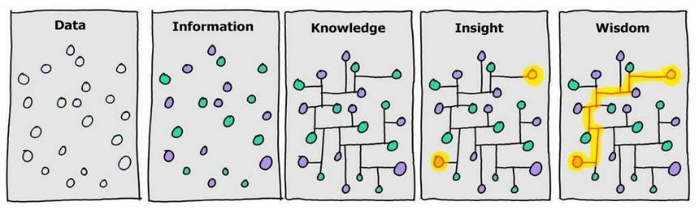
2.1 ANALYTICAL THINKING IN BASICS
“On average about forty percent of the human mind consists of data, thirty percent information, twenty percent knowledge, ten percent understanding, and virtually no wisdom” (Ackoff, 1989, 3).
Data - is represented by a series of random dots that could mean something – or nothing.
Information - is where meaning or relationship is applied to the raw material. This is indicated by applying different colours to the dots.
Knowledge - is gained when we are able to memorize the information, for i.e. standard multiplication tables or sunrise & sunset times in a given month. As we gain knowledge we begin to make sense of things and draw connections between different pieces of information.
Insight - is the level where data becomes seriously useful. Insight is the ability to synthesize knowledge in order obtain a deep understanding of a problem. With insight comes the prospect of
Wisdom – the ability to use insight to facilitate informed decision making.
Original graphic by Hugh MacLeod @hughcards, extended by David Sommerville @smrvl

Slide 10
2.2 THE ART OF THINKING
What is cognition? The ability to process information through perception, knowledge acquired through experience, and our personal characteristics that allow us to integrate all of this information to evaluate and interpret our world.
It is the ability that we have to assimilate and process the information that we receive from different sources (perception, experience, beliefs, etc.) and convert them into knowledge. It includes different cognitive processes, like learning, attention, memory, language, reasoning, decision making, etc., which are part of our intellectual development and experience.
What Is Logical Thinking?
The logical thinking definition is analyzing a situation or problem using reason and coming up with potential solutions. Logical thinkers gather all the information they can, assess the facts, and then methodically decide the best way to move forward.
What Is Logical Reasoning?
Logical reasoning is a type of problem-solving that involves working through a set of rules that govern a scenario. This set of rules or steps is referred to as an algorithm. Logical reasoning involves testing different sets of steps - or algorithms - to determine which sequence of rules leads to the correct solution
„ Logical thinking is an essential tool in the workplace to help analyze problems, brainstorm ideas, and find answers. Employers want employees who can come up with the right solutions that are financially reasonable, probable, and actionable.“

Slide 11
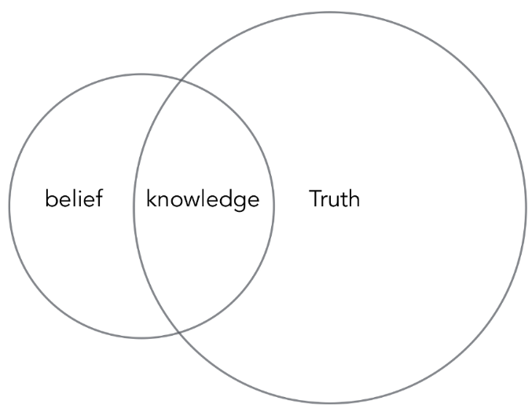
2.3 THE TRAP CALLED BELIEF SYSTEMS
Belief systems are the stories we tell ourselves to define our personal sense of Reality. Every human being has a belief system that they utilize, and it is through this mechanism that we individually, “make sense” of the world around us.
Reason cannot prove the beliefs it is based upon. Beliefs arise through experience. Experience needs previous beliefs and reason to be assimilated, and reason needs experience to be formed, as beliefs need reason as well. Beliefs, reason and experience, are based upon each other. Context is dynamic, and formed upon beliefs, reason and experience. This is where relative understanding lies.
As relative understanding is independent of our context, it is also dependant on our beliefs, reasoning, and experiences. Contexts are dynamic because they are changing constantly as we have new experiences and change our beliefs and our ways of reasoning.
https://medium.com/perspectivepublications/the-difference-between-belief-and-knowledge-cb909520a265

Slide 12
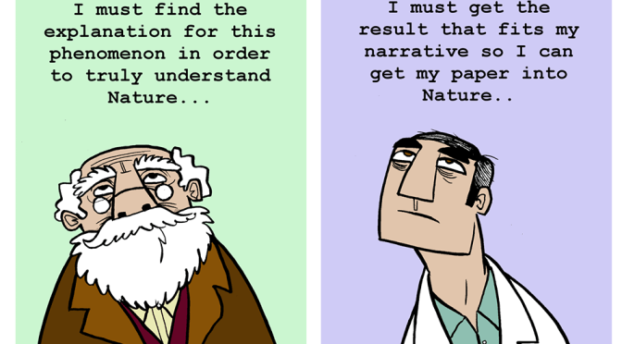
2.4 OPEN MINDEDNESS, SKEPTICISM IN CRITICAL THINKING
Open-mindedness is about being open to changing your mind in light of new evidence. It’s about detaching from your beliefs and focusing on unbiased thinking void of self-interest. It’s about being open to constructive criticism and new ideas.
„On the other hand, seemingly, the disposition towards scepticism refers to an inclination to challenge ideas; to withhold judgment before engaging all the evidence or when the evidence and reasons are insufficient; to take a position and be able to change position when the evidence and reasons are sufficient; and to look at findings from various perspectives.“
A degree of skepticism is quite healthy as a counterpoint to being too credulous and being taken in by poor reasoning and illusions and deliberate attempts to mislead and deceive. Skepticism that holds that it is not possible to have knowledge is self defeating and not productive. There should be a skeptical inquiry that is used before humans reach conclusions and decide which beliefs they will hold.
https://www.euroscientist.com/open-scientists-in-the-shoes-of-frustrated-academics-part-i-open-minded-scepticism/

Slide 13
2.5 DISPOSITIONS OF CRITICAL THINKER
12 personal traits to work on to become a flexible, adaptable, and complex critical thinker, resilient , and sought-after individual, and worker:
Inquisitiveness,
Self-efficacy
Attentiveness
Organization
Creativity
Reflection
Open-mindedness
Intrinsic goal orientation
Perseverance
Truth-seeking
Skepticism
Resourcefulness

Slide 14
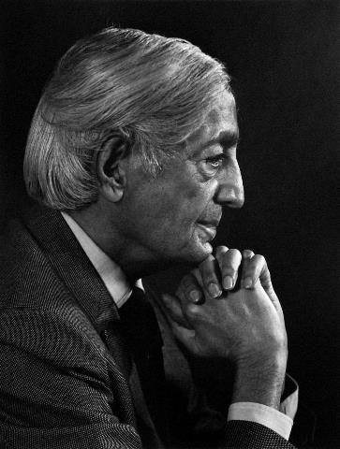
2.6 FINAL THOUGHT
Wisdom is something that has to be discovered by each one, and it is not the result of knowledge. Knowledge and wisdom do not go together. Wisdom comes when there is the maturity of self-knowing. Without knowing oneself, order is no possible, and therefore there is no virtue.
- Krishnamurti, The Book of Life
Krishnamurti, 1982 by Yousuf Karsh

Slide 15

3.1 CONTINUOUS LEARNING FUNDAMENTALS
“Study without desire spoils the memory, and it retains nothing that it takes in.”
— Leonardo da Vinci
Have you ever come across terms e-learning, learning by doing, visual learning, or any other type of learning?
Take a minute a try to explain what learning is according to your opinion…
Learning can be… process, outcome, change of state, acquirement of knowledge, development, contextualization, experiencing, acquiring the language of different disciplines, both memorization and understanding, modification of a behavioral tendency by experience, strengthening correct responses, weakening incorrect responses …

Slide 16


3.1 CONTINUOUS LEARNING FUNDAMENTALS
Continuous Learning:
also known as lifelong learning;
refers to an old concept rises in its popularity since the trend of continuous skill gaps in leading industries and the onset of e-learning;
represents process, culture, and mindset of learning new knowledge, capabilities and skills requiring dedication and specific methods;
stands beyond a formal education based on the ongoing, self-motivated, and voluntary pursuit of professional or personal development
takes place through both formal and informal approaches;
is also an evitable approach to future-proof education by upskilling your knowledge before the need arises .
Watch this short video to learn how to boost a lifelong learner in you!
How would you approach continuous learning in your everyday life?
Look at the forms of continuous learning:
mentorship programs; peer discussion groups; certification programs; workshops; relevant online/offline sources i.e., newsletters, research databases or YouTube channels of your interest; team-building sessions; conferences; study programs at your workplace; learning by teach someone else, etc.

Slide 17

3.2 UNLEARNING
"No problem can withstand the assault of sustained thinking." — Voltaire
What are the ways to actively unlearn in your work?
Seek out people with different experiences for listening to them in order to find a possible new perspective in our thinking even if we do not necessarily have to agree with them.
Increase your awareness by testing your own habits. Using unconscious (automatic) habits may create mental shortcuts. Try to pick up some habits and unlearn them consciously, i.e. if you automatically solve a problem, try to ask someone else for their opinion, or if you habitually arrange meetings, leave it to somebody else.
Ask yourself propelling questions that will prevent your existing knowledge from limiting your ability to imagine new possibilities. For example: In 2030 – What will be the most significant changes in your business field? Which of your strengths you could transfer to any other sector?
Unlearning
Unlearning is a part of continuous learning since it refers to the replacement of familiar and safe thinking and behavior patterns with new and unknown ones. Even though your skills brought you to your current position they might hold you back to go further or sometimes are the results of a vis major like we experienced during the pandemic such as saying always yes even your workload rises or significant shift in work or school collaboration during the COVID-19 lockdowns.

Slide 18
3.3 LEARNING STRATEGIES
Spacing - To strengthen your memory of learning new things it’s better to study in smaller chunks over time. Even though you’re able to learn all material the night before the exam you’ll not probably remember it in a couple of weeks. Through this method you’ll learn a bit of information, then you’ll forget a bit of it, and finally, you’ll relearn it again. For this strategy, you need to create a studying calendar where you’ll include current and previously learned material.
Retrieval Practice - Recalling information without supporting materials helps you learn more effectively by changing the way information is stored. Try to retrieve information from your memory instead of tricking yourself into considering you know something by having information in front of you (such as re-reading notes). You might try speaking out, sketching, or writing down the information and then comparing it with the learning materials or checking them with your teacher.
Interleaving - To learn a new skill more effectively and think flexibly you might mix it with other skills rather than practicing the one repeatedly.

Slide 19
3.3 LEARNING STRATEGIES
Elaboration - This technique follows up the retrieval practice by making connections within the information using open-ended questions (what, how, why) and searching for detailed answers, i.e., in a form of a brief class discussion.
Concrete Examples - Imagine concrete examples while you are learning abstract concepts. Try to come up with the ideas and then verify them in your textbook or with a teacher.
Dual Coding - When you are studying, pay attention not only to the text but also to the visuals (graphs, images, diagrams) and try to explain them in your own words.

Slide 20



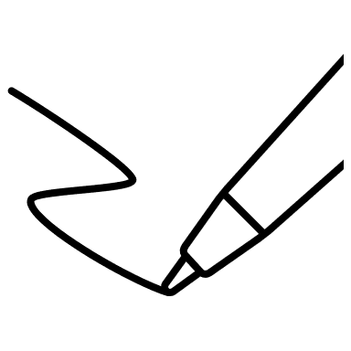
3.3 LEARNING STRATEGIES
Find out more and watch 6-minutes video of Elon Musk’s 2 Rules For Learning Anything Faster
Tips for note-taking strategies!
Use a graphic organizer for writing main ideas or breaking down a concept
Sketch or draw the information down and create an interactive notebook with written notes included
Provide longhand writing that forces you to put more effort into translating information than typing on a computer

Slide 21
Summing up
Adaptability is a skill that you can use to more effectively respond to the ever-changing world around you.
Continuous learning refers to the ongoing, self-motivated pursuit of professional, cognitive/health, emotional, and other personal development beyond the scope needed to relate to far more people including yourself.
Logical thinking helps to analyze problems, brainstorm ideas, and find answers. Employers want employees who can come up with the right solutions that are financially reasonable, probable, and actionable.“
Soft skills are uniquely human skill and future human skills cannot be replaced by robots or Al.

Slide 22
just-training.eu
Thank you!

